Slide 1

community-maintained slides
August 2026

Slide 2
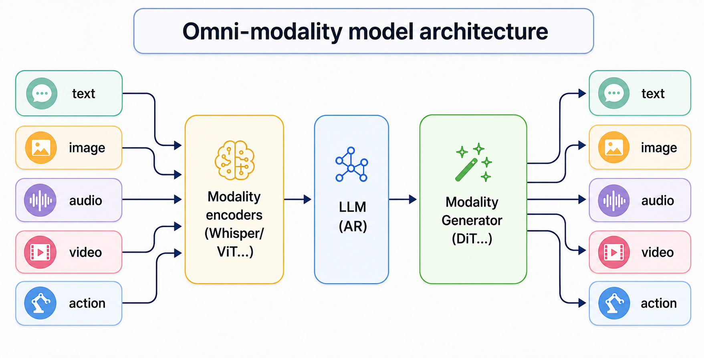
Why vLLM-Omni exists
Source: vLLM-Omni v0.26.0 architecture
02

Slide 3
Our goal
Build the
fastest and easiest-to-use
open-source omni-modality model
inference & serving engine
Source: vLLM-Omni project mission and v0.26.0 repository README
03

Slide 4
What vLLM-Omni extends
Omni-modality
Beyond
autoregression
Heterogeneous
outputs
Text, image, audio and video can enter the same serving pipeline.
DiT and other parallel generators need execution loops beyond token-by-token decoding.
One request can return text, images, audio, video—or actions.
One serving layer across different execution loops and outputs.
Source: vLLM-Omni v0.26.0 README and architecture overview
04

Slide 5







Broad model support, one serving surface
Omni and speech
Image generation
Qwen3-Omni · MiniCPM-o · Voxtral TTS · Fish Speech
Qwen-Image · FLUX · LongCat · Z-Image
Video and world models
Multi-stage generation
Wan · HunyuanVideo · Cosmos
BAGEL · GLM-Image · HunyuanImage
Support is model-, backend- and feature-scoped; the tagged model table is authoritative.
Source: vLLM-Omni v0.26.0 docs · logos from community template
05

Slide 6






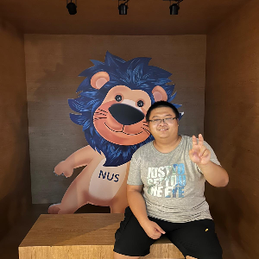



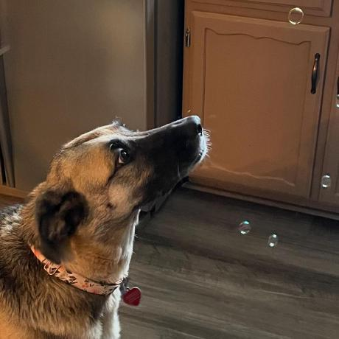



318 commit contributors powered v0.26.0
Top 14 by authored commits
Thank you
Public GitHub profiles · ordered left to right
for raising issues,
joining discussions,
reviewing changes, and
submitting PRs.
+304 more
The count tracks commit authors only;
community participation is broader.
317 linked GitHub accounts + 1 unlinked author identity
through v0.26.0
Source: GitHub commits reachable from v0.26.0 · avatars: public profiles
06

Slide 7



vLLM-Omni 0.26.0 on GitHub
github.com/vllm-project/vllm-omni
5,802
uv pip install vllm==0.26.0 --torch-backend=auto
uv pip install vllm-omni==0.26.0
active stars at release
Aug 3, 2026
Cumulative active stargazers
6k
v0.26.0 · 5,802
4k
2k
0
Oct
Dec
Feb
Apr
Jun
Aug
Reconstructed from current active-stargazer timestamps; prior unstars are not retained.
Source: GitHub REST API · v0.26.0 published 2026-08-03
07

Slide 8
vLLM-Omni 0.26.0
release
vLLM-Omni Team · Community release update · Aug 2026
08

Slide 9
What changed in vLLM-Omni 0.26.0
Four chapters · nine-slide release section · approximately eight minutes
01
Multimodal generation
02
Realtime interaction
MiniMax H3 · workflows + optimization roadmap
Experimental MiniCPM-o 4.5 duplex
2 min
2 min
03
Scale diffusion
04
Adopt v0.26
Distributed offload · mechanism + validated evidence
Runtime alignment · broader stack · upgrade notes
3 min
1 min
Source: vLLM-Omni v0.26.0 release notes
09

Slide 10
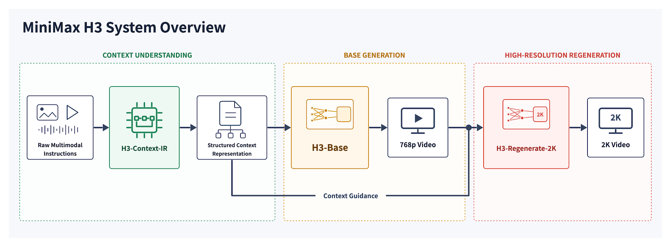
MiniMax-H3: context to 2K audio-video
Three modules separate context understanding, base generation, and high-resolution regeneration.
H3-Context-IR
Hosted context structuring
Not open-sourced
H3-Base
Local 768p generation
32 kHz stereo
H3-Regenerate-2K
Hosted in-context 2K
Not open-sourced
vLLM v0.26.0 serves H3-Base FL2VA / Ref2VA locally · CUDA · ROCm · Ascend.
Source: MiniMax H3 overview · v0.26.0 recipe · license
10

Slide 11
MiniMax H3: optimizing memory, kernels, and repeated work
POST-0.26 ROADMAP · Issue #5700 · status checked 2026-08-05
Post-tag work targets memory, kernels, and repeated work.
MERGED AFTER TAG
OPEN PR
OPEN PR
Online FP8 DiT
Fused QK norm + 3D RoPE
AdaLN schedule cache
−22%
1.865×
−11.259 GiB
68.52 → 53.51 GiB/GPU
2×H100 · 107 f · 10 steps
Resident-only; no layerwise offload.
B300 BF16 · 100 iterations
Bitwise exact · kernel-only.
Per GPU steady · −1.95% wall
2×H20 TP2 · 50 steps · opt-in
Byte-identical · ~10 s miss.
Next: 2×RTX DLO · packed attention · Cache-DiT · batching · encoder split · perf CI
Source: MiniMax H3 follow-up roadmap #5700 · PRs #5737, #5773, #5783
11

Slide 12
MiniCPM-o 4.5: experimental full duplex
Streaming input and output can overlap—enabling model-directed listen/speak, cancellation, and barge-in.
Endpoints: /v1/duplex · /v1/realtime?duplex=1
WebSocket
Session
Control / data
MiniCPM Stage 0
TTS / Token2Wav
→
→
→
→
audio + frames
turn + playback
runtime
listen / speak
audio chunks
↶ Playback acknowledgement · overlap handling · cancel / barge-in
streaming audio I/O
model listen / speak policy
playback-aware history
Experimental: persistent KV, recovery, long-run tuning, and Realtime parity remain incomplete.
Source: v0.26.0 full-duplex design · PR #3907
12

Slide 13
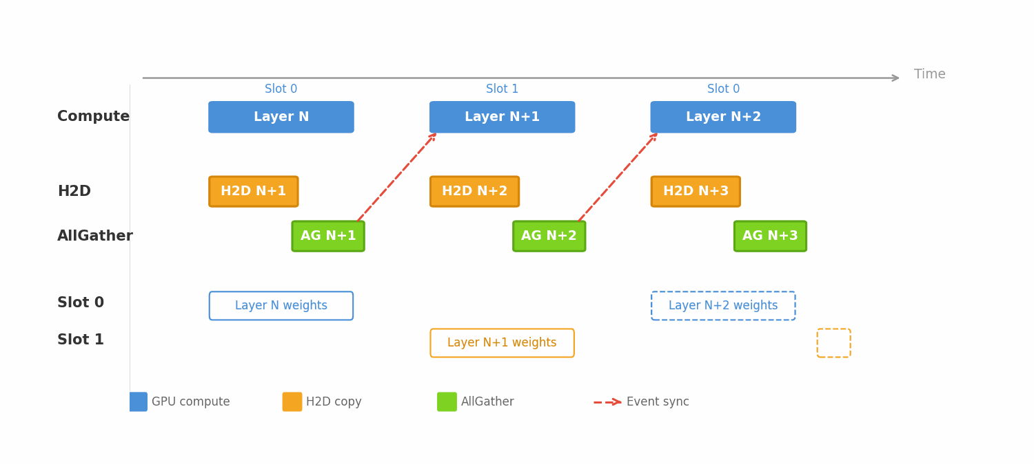
DLO: reconstruct each layer just in time
mmap → host sharding → H2D + AllGather → two-slot compute / prefetch
Source: website PR #295 · PR #5397 · NPU validation
13

Slide 14
DLO results: memory, throughput, long video
DLO lowers memory; DP lifts throughput; SP preserves latency.
ASCEND · COLD START
ASCEND · 832×480 · 29 F
B300 · 720P · 241 F
Memory
Throughput tradeoff
Long video
−73%
−53.5%
3.3×
178 → 47 GB peak
36 → 12.1 GB/GPU
214.53 s · 24.99 GiB
+2.13% latency
HSDP 0.967 fps
DLO 0.806 → 3.22 fps
Nano · DP4 · 4×910B3 · 4 req.
Kernel-DMA shards excluded.
35 steps · 12.4 GB/card
−17% at one request.
35 steps · USP4 · 4×B300
Byte-identical · vLLM 0.25.0.
Nano DP2/DP4: 35 steps · Super: five-step smoke · B300: non-isolated
Source: website PR #295 · PR #5397 validation evidence
14

Slide 15
v0.26 broadens the production stack
Runtime alignment meets broader model and platform support.
Core runtime
Diffusion
Aligned with vLLM 0.26 · serving and metrics correctness
Midway prompt updates · asynchronous image output · OmniGen2 sequence parallelism · expanded FLUX parallelism
Models
Platforms and delivery
Krea 2 · Cosmos3 Edge / Distilled · LingBot Video · MammothModa2-Dev
Expanded Ascend / XPU / MUSA coverage · restored ROCm CI · additional deployment recipes
Source: vLLM-Omni v0.26.0 release notes
15

Slide 16
Adopt v0.26: three checks before rollout
Pair versions, update LTX registry names, and install the external GGUF plugin when needed.
Runtime alignment
LTX registry migration
GGUF moved out of tree
uv pip install
vllm==0.26.0
--torch-backend=auto
uv pip install
vllm-omni
LTX23Pipeline → LTX2Pipeline
Image-to-video variants → LTX2Pipeline with image=
Two-stage variants → LTX2DistilledPipeline
uv pip install
vllm-gguf-plugin>=0.0.3
Use the external plugin for GGUF-backed diffusion workflows.
Preview status: MiniCPM-o 4.5 full duplex remains experimental.
Source: v0.26 quickstart · LTX-2 recipe · GGUF guide
16

Slide 17
vLLM-Omni
roadmap
Q3 2026 · Productionize, scale, standardize
17

Slide 18
Q3 roadmap: productionize, scale, standardize
Open roadmap #4901 · six workstreams grouped into four outcomes.
Realtime production
World + diffusion
Reliable full-duplex flow · reproducible demos · JoyVL / MiniCPM-o.
World-model coverage · fused kernels · DiT KV cache · DP / EP / PP.
Core at scale
Developer flywheel
Refactor config, orchestration, schedulers, connectors, logging, and benchmarks.
RL batch invariance · onboarding standards · AI-assisted sync, review, and CI debugging.
Source: vLLM-Omni Q3 roadmap · issue #4901 · open 2026-08-06
18

Slide 19
Build with us
Code, docs, discussion, and public meetings—choose where to start.
Build & report
Learn & contribute
github.com/vllm-project/vllm-omni
Code · issues · reviews
docs.vllm.ai/projects/vllm-omni
Setup · model guides · design docs
Discuss
Public meetings
slack.vllm.ai · #sig-omni
discuss.vllm.ai
vllm.ai/events
English meeting notes
Source: vLLM-Omni Contact Us · Contributing
19

Slide 20
SYSTEM WALKTHROUGH · v0.26.0 · a4ea67a
vLLM-Omni
system walkthrough
Appendix · architecture to execution
20

Slide 21
Goals of the system walkthrough
Follow one request—from model pattern to runtime placement.
01 · Model patterns
02 · Request lifecycle
Recognize DiT-main, AR-main, and mixed AR + generator pipelines.
Trace entry points through orchestration into stage engines.
03 · Topology vs deployment
04 · Connectors & scaling
Separate fixed pipeline meaning from YAML runtime knobs.
Understand payload transport, overlap, and stage replicas.
Source: vLLM-Omni v0.26.0 · architecture + stage configuration
21

Slide 22
One architecture spans every modality
Encode any modality, reason with AR, then generate the target modality.
Source: latest architecture overview · updated Aug 9, 2026
22

Slide 23
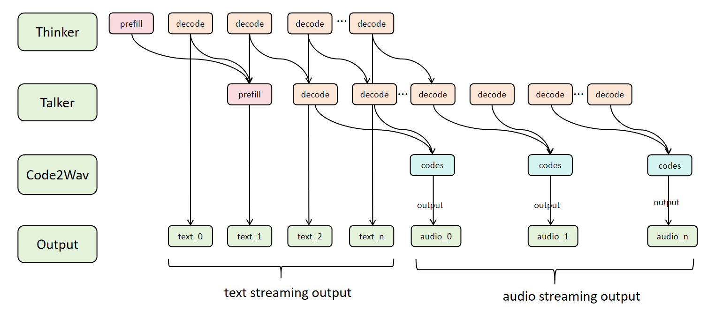
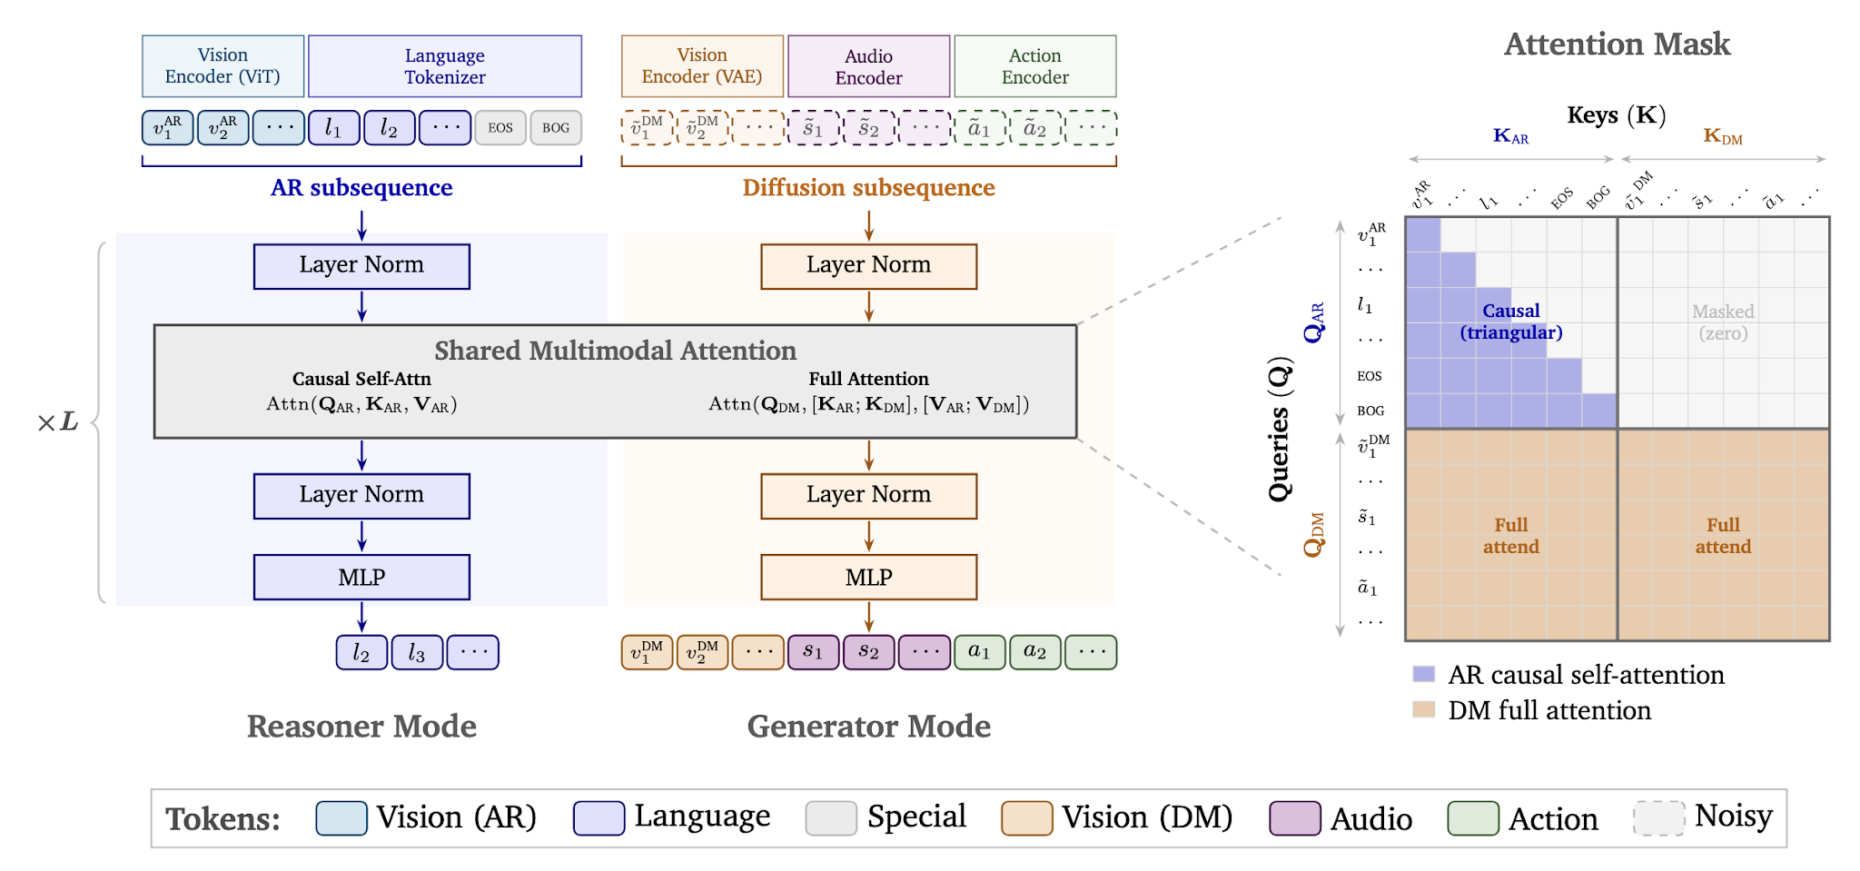
Three models, three execution structures
Streaming AR, co-located diffusion, and unified MoT map to stages differently.
Qwen3-Omni
MiniMax-H3
Cosmos 3
Thinker → Talker → Code2Wav
Text Encoder → DiT → VAE Decoder
AR reasoner → diffusion generator
Three independently scheduled stages stream text and audio incrementally.
Logical components remain co-located inside one diffusion stage.
Diffusion attends to AR context while the reasoner remains causal.
Sources: architecture overview · MiniMax-H3 · Cosmos 3
23

Slide 24
Each stage owns its execution policy
Batching, attention, parallelism, quantization, and metrics are stage-local.
Runtime concern
AR runtime
Diffusion runtime
Execution loop
Next-token decode
Denoising steps
Batching
Continuous token batching
Request or step batching
Attention
Causal attention + KV cache
Full or mixed attention
Parallelism
TP / EP by AR deployment
TP / SP / CFG / EP by pipeline
Quantization
Checkpoint-specific
Component / pipeline-specific
Primary metrics
TTFT · TPOT
E2EL · throughput · RTF
A stage is a logical execution unit—not necessarily a separate process.
Source: latest architecture overview · updated Aug 9, 2026
24

Slide 25
StageRuntime materializes logical stages
Topology, placement, control, and transport stay in separate layers.
Entry points
AsyncOmniEngine
Orchestrator
Stage runtime
Stage execution
API server
Omni / AsyncOmni
composition root
background loop
state · route
cancel · order
placement · replicas
readiness · lifecycle
AR + diffusion
scheduler · worker
PipelineConfig · topology + relationships
DeployConfig · placement + resources
OmniConnector · payload + KV transport
Source: latest architecture overview · updated Aug 9, 2026
25

Slide 26
Public interfaces share one engine boundary
Offline, online, and duplex requests use the same configured stages.
Offline Python
Online serving
Experimental duplex
Omni.generate()
vllm serve … --omni
/v1/duplex · realtime duplex
AsyncOmniEngine
Configured stages
Streaming / final output
Same engine boundary
Model-specific routes
Output-aware metrics
shared request lifecycle
endpoint support varies
TTFT · TTFP · E2EL · RTF
Source: latest architecture overview · updated Aug 9, 2026
26

Slide 27
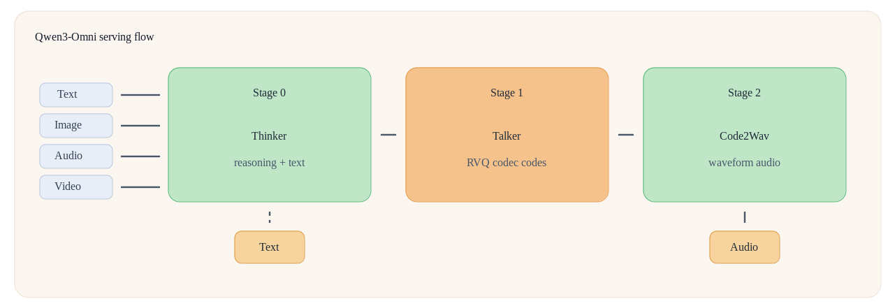
Qwen3-Omni: three serving workloads
Thinker → Talker → Code2Wav exposes three compute profiles.
TAKEAWAY
Three compute profiles require stage-local batching, graph capture, handoffs, placement, and replicas.
Source: website PR #258 · merged 2026-07-03
27

Slide 28
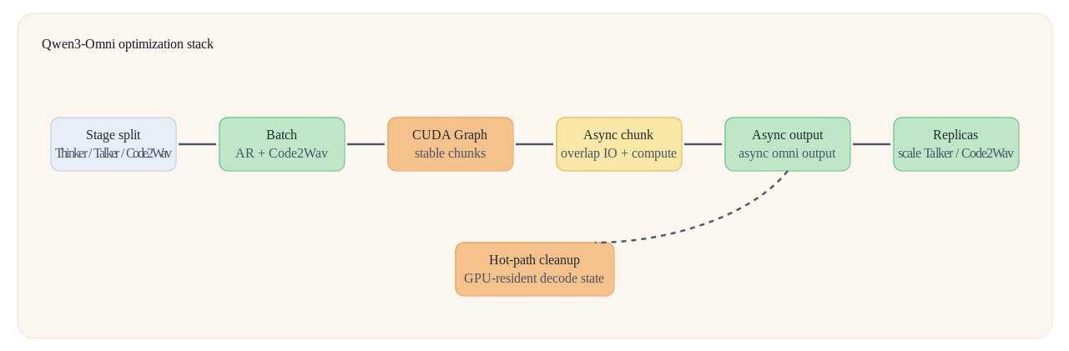
Qwen3-Omni performance is a stack
Each cumulative benchmark row targets a different bottleneck.
Stage split → batching → CUDA Graph → async chunk → async output → replicas, with cleanup underneath.
Source: website PR #258 · merged 2026-07-03
28

Slide 29
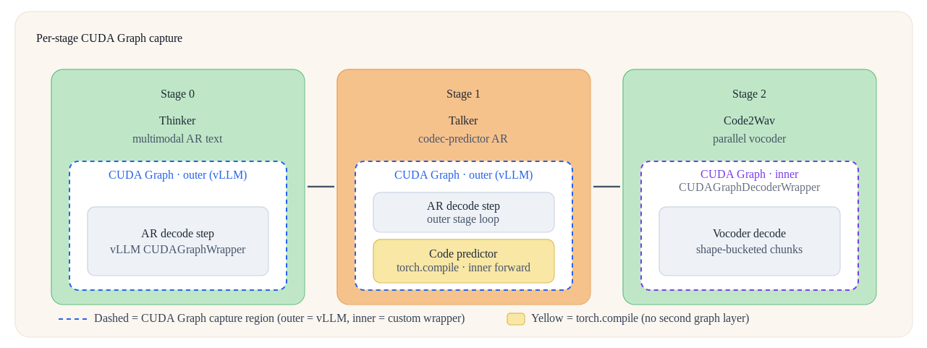
CUDA Graph capture is stage-local
Outer AR graphs + compiled predictor + inner bucketed vocoder graph.
C64 cumulative step: 2.2→8.6 req/s · TTFP 5884→2790 ms · RTF 1.15→0.59
Source: website PR #258 · merged 2026-07-03
29

Slide 30
Connectors make stage handoffs explicit
Payloads carry stage meaning; transport and scheduling stay reusable.
Orchestrator
+ StagePool
→
Payload
processor
→
Transfer
adapter
→
Transport
put / get
→
Next stage
scheduler
THINKER → TALKER
TALKER → CODE2WAV
Hidden states + embeddings + chunk metadata; chunk 0 carries the full Thinker prefill.
Codec codes + chunk metadata cross the boundary; Code2Wav can consume partial chunks.
WHY
MECHANISM
GAIN
Handoffs are heterogeneous.
Connectors define payload and lifecycle at each boundary.
Stage runtimes stay decoupled as streaming and cleanup evolve.
Later Thinker steps send only the new embed.decode row—connector traffic stays O(1) per step.
Source: website PR #258 · merged 2026-07-03
30

Slide 31
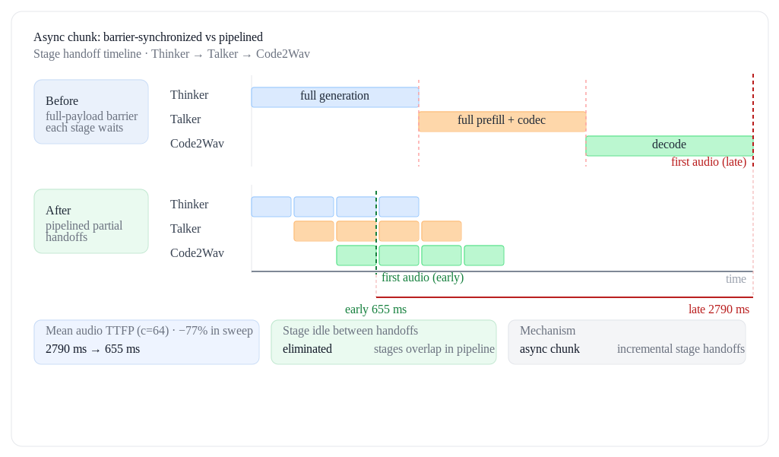
Async chunk pipelines stage handoffs
Partial handoffs overlap upstream decode with downstream compute.
WHY
Full-payload barriers delay first audio.
MECHANISM
Incremental codec chunks overlap stage compute and transfer.
C64 GAIN
TTFP 2790→655 ms
−77%
Source: website PR #258 · merged 2026-07-03
31

Slide 32
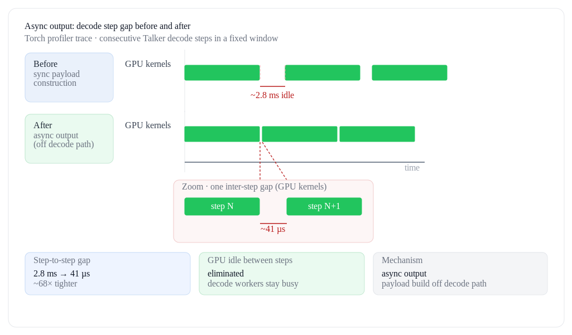
Async output removes decode stalls
Payload assembly moves off the decode path.
ASYNC CHUNK
Removes inter-stage full-payload barriers.
ASYNC OUTPUT
Builds connector payloads away from the decode worker.
C64 RESULT
Req/s: 9.3→11.3
TTFP: 655→631 ms
RTF: 0.63→0.47
Source: website PR #258 · merged 2026-07-03
32

Slide 33
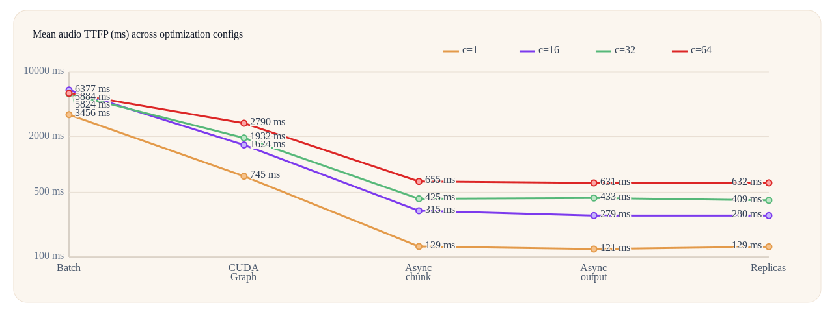
C64: first-audio latency falls 89%
Cumulative sweep from Batch to graphs, async handoffs, and replicas.
5.4×
throughput
2.2→11.7 req/s
−59%
mean RTF
1.15→0.47
Seed-TTS en · Qwen3-Omni-30B-A3B-Instruct · c=1/16/32/64 · 5 warmups · GPUs 0/1/2 · server restart per config
Source: website PR #258 · merged 2026-07-03
33

Slide 34
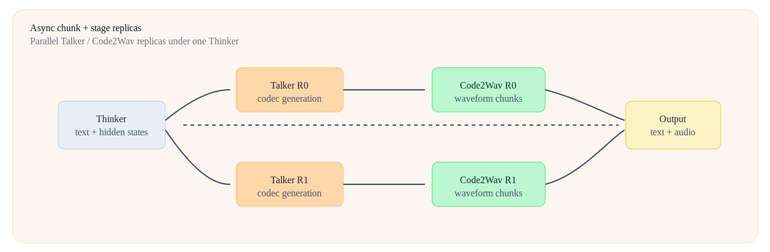
Replicate only saturated speech stages
One Thinker feeds 2× Talker and 2× Code2Wav.
C64 replica-only increment: 11.3→11.7 req/s (+4%) · TTFP 631→632 ms · RTF 0.47→0.47. Selective capacity—not tensor parallelism or autoscaling.
Source: website PR #258 · merged 2026-07-03
34

Slide 35
Hot-path cleanup removes per-step work
After framework-level wins, eliminate work that scales with utterance length.
DECODE DELTA
PAYLOAD + EXECUTOR
Chunk 0 ships full prefill; later steps send only the new embed.decode row—O(1) connector traffic per step.
Remove repeated torch.cat and unneeded CPU payloads; single-GPU uses uni instead of implicit mp.
GPU-RESIDENT STATE
PREDICTOR REWRITE
Keep hidden/trailing text, tts_pad_projected, and codes on device; skip mRoPE work in speech stages.
Re-prefill + SDPA/native GQA + inline top-k + cached refs + torch.compile; keep RMSNorm/RoPE in fp32.
Separate long-context test: E2EL 21.28→7.37 s · TTFP 3197→1796 ms · RTF 0.71→0.28
Source: website PR #258 · merged 2026-07-03
35

Slide 36
Support is a verification workflow, not a matrix
A check mark is not enough—verify release, backend, recipe, and tests.
01 · PIN THE CLAIM
02 · FIND TAGGED SUPPORT
Model · feature · backend · v0.26 commit
Supported-model and feature docs
03 · BUILD DEPLOY CONFIG
04 · VERIFY ON TARGET
Recipe · deploy YAML · capability gates
Hardware · test artifact · date
Evidence record = model + backend + feature + commit + recipe + test + hardware + date
Source: v0.26.0 supported models · Issue #1217 context
36

Slide 37
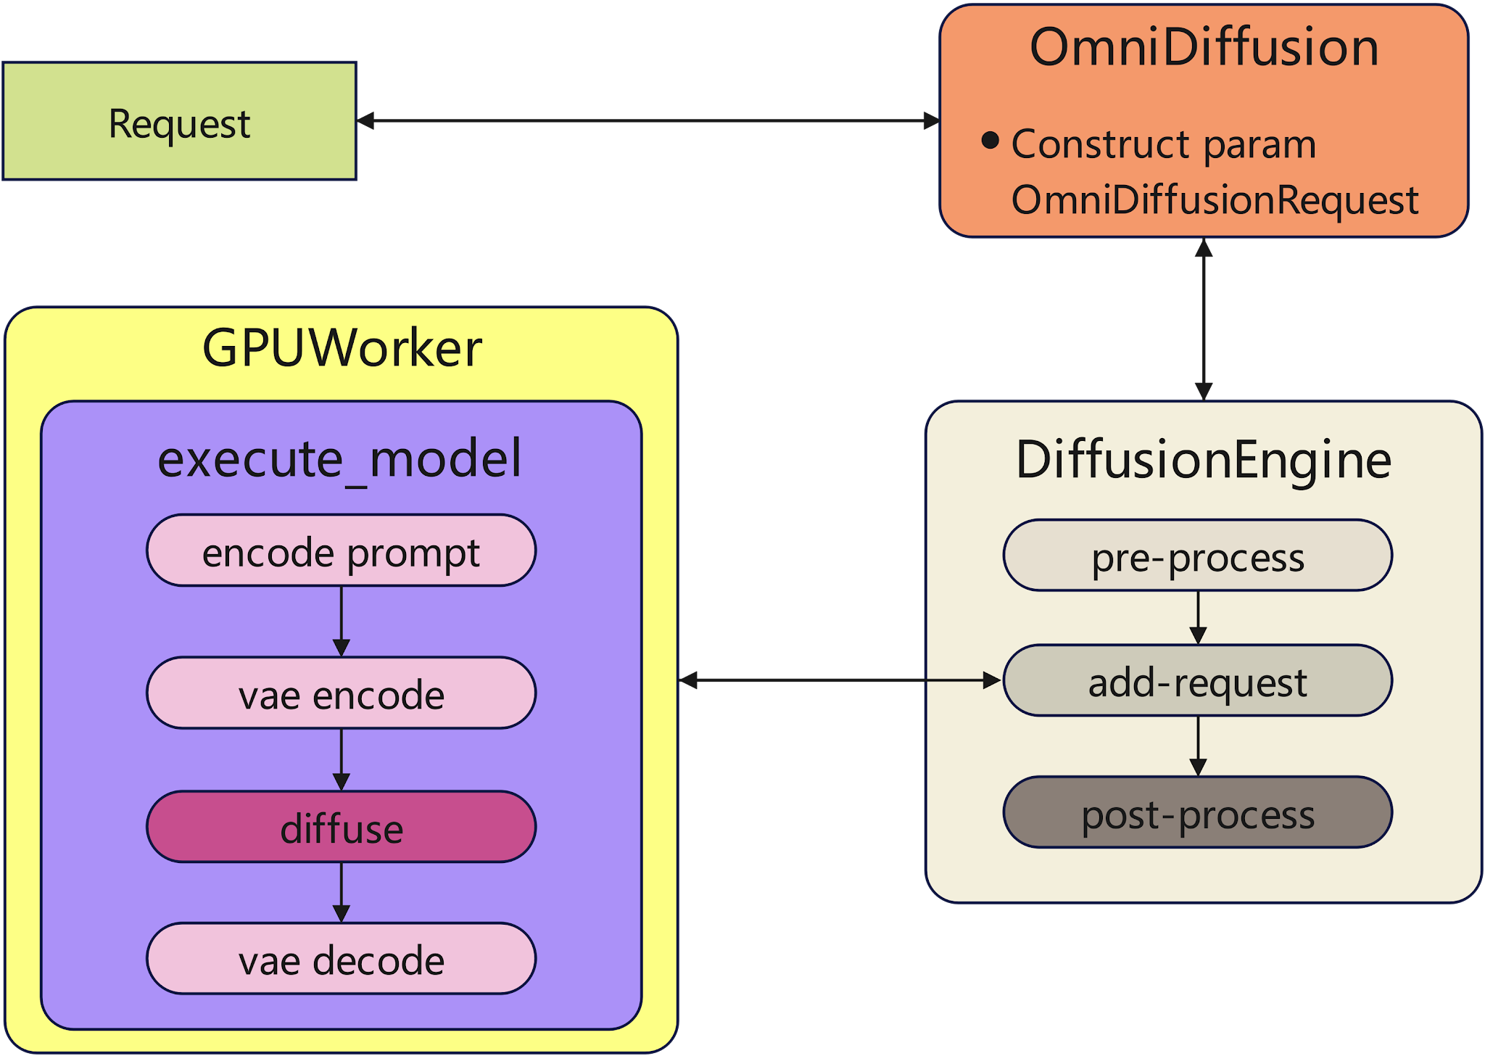
Diffusion separates control from execution
The request path is stable; acceleration layers remain model- and stage-specific.
CONTROL
Request → DiffusionEngine → scheduler
EXECUTION
Executor → worker → model runner → pipeline
FEATURES
Cache · parallelism · quantization · offload · LoRA · attention
Phases: prompt encode → optional VAE encode → denoise → VAE decode · figure shows request-mode path
Source: v0.26.0 adding a diffusion model + DiT module
37

Slide 38
Diffusion batching has two different contracts
Choose a full-request batch or a step-wise batch; both need compatible request shapes.
REQUEST-LEVEL · step_execution=false
STEP-WISE · step_execution=true
One full pipeline forward() over a static batch
Pipeline opts in with supports_request_batch=True
Optional bounded wait coalesces bursty ingress
Scheduler may admit work between denoise steps
denoise_step() shares one active InputBatch
Experimental; multi-request support is pipeline-specific
Compatibility: spatial / temporal shape · CFG / guidance · output count · LoRA identity + scale
Source: v0.26.0 request-level batching · step-wise batching
38

Slide 39
Choose parallelism by bottleneck, then verify
Each axis addresses a different memory or compute limit.
Bottleneck
Method
Configuration knob
DiT weights / compute
Tensor parallel
tensor_parallel_size
Full transformer weight memory
HSDP (FSDP2)
use_hsdp · hsdp_shard_size
Long visual-token sequence
Ulysses / Ring SP
ulysses_degree · ring_degree
Positive + negative CFG branches
CFG parallel
cfg_parallel_size
Deep transformer blocks
Pipeline parallel
pipeline_parallel_size
MoE expert weights
Expert parallel
enable_expert_parallel
VAE activation peak
VAE patch / tile
vae_patch_parallel_size
HSDP ≠ TP · EP group must exceed 1 · VAE patch degree fits the DiT group
HSDP replica groups are not StagePool stage replicas
Source: v0.26.0 · diffusion parallelism guides
39

Slide 40
Unified quantization, stage-specific scope
One API; validate method, stage, backend, and hardware.
1 · CONFIGURE
2 · SCOPE
3 · SELECT
4 · VALIDATE
quantization_config
or --quantization
→
intended transformer
or AR stage
→
online or
pre-quantized
→
model · backend
hardware · quality
ONLINE
PRE-QUANTIZED
PLUGIN
FP8 W8A8 · Int8 W8A8 · MXFP8 W8A8
MXFP4 W4A4 · BitsAndBytes W4
ModelOpt · AutoRound · msModelSlim
serialized Int8 · offline MXFP8 / MXFP4
GGUF via
vllm-gguf-plugin
Quantize the heavy transformer path; keep precision-sensitive components in BF16 unless support is explicit.
Source: v0.26.0 quantization overview · BitsAndBytes · GGUF
40

